Slide 1
Color Classification
Danielle Gauthier
Summer 2026 MSDS 422
Kaggle Dataset by Aydin Ayanzadeh

Slide 2
Danielle Gauthier
Contents
Summer 2026 MSDS 422
1.
Problem statement
2.
Assumptions and EDA
3.
Modeling Strategy
4.
Results
5.
Practicality
6.
Next Steps

Slide 3
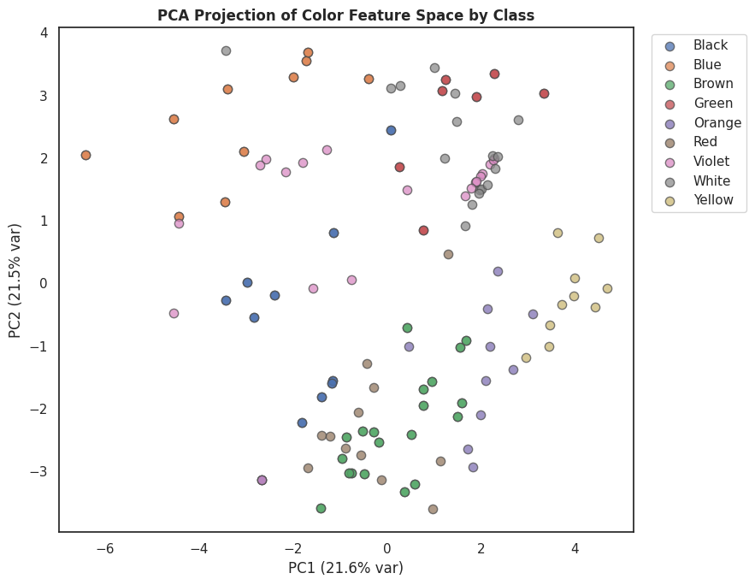
Danielle Gauthier
What is the best method for accurately classifying an image’s color?
Summer 2026 MSDS 422
Color sorts variables when labels denote sensory meaning. A meaningful color range supports the Law of Requisite Variety.
Which colors are the best predictors, and how few are needed?
Dataset: 9 real color classes (black, blue, brown, green, orange, red, violet, white, yellow) extracted from image color-space statistics.

Slide 4
Company Name
Project Roadmap
Goal
Step 1
Step 2
Step 3
Step 4
Year/Quarter/Month
Extract: per-image color features across RGB, HSV, and CIELAB (means, stds, 8-bin hue histogram, normalized chromaticity).
Clean: drop non-color folders (mask_*, testimg); keep 9 true color classes.
Engineer: normalize chromaticity (r+g+b=1); select top predictors by importance.
Model & correct: fit models, test collinearity (VIF), evaluate with cross-validation.
Identify the smallest set of color predictors that classifies reliably.

Slide 5
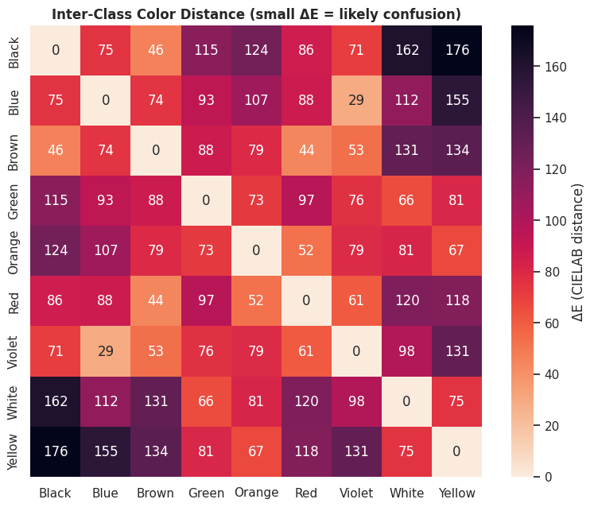
Danielle Gauthier
Exploratory Data Analysis
Summer 2026 MSDS 422
Assumption 1
The masking assumption. Every feature depends on a background mask (keep pixels where 20 < gray < 235). The threshold silently defines which pixels count as "the object," so measured color is sensitive to it.
Class distribution is imbalanced (Brown ~40 down to Yellow/Orange ~10) → handled with class_weight='balanced'.
Inter-class ΔE (CIELAB distance) predicts confusions before modeling: Orange/Brown and Black/White/Violet sit closest.
Assumption 2
Chromaticity vs. lightness. Normalizing r+g+b=1 discards lightness. This assumes hue carries the signal — true for red/blue/green, but it collapses black, white, and grey (which differ only in L). CIELAB distance also assumes perceptual uniformity (only approximately true).

Slide 6
Danielle Gauthier
Modeling Strategy
Model
Role
Single-predictor logistic (rgb_b_std alone)
Baseline — shows one channel statistic can't separate color (macro-F1 near 0). Motivates multi-feature models.
1
Multilinear logistic, collinearity-corrected, top 3 predictors
Tests VIF before/after and prunes collinear predictors (raw RGB means hit VIF 86–93).
Satisfies the "correct for collinearity" requirement.
2
Indicator model (16 standard-color anchors)
Nearest-anchor one-hot dummies → multinomial logistic. Interpretable indicator/dummy-variable model.
3
Summer 2026 MSDS 422
Top predictors: lab_b_mean, lab_a_mean, hue_bin_6 (hue_bin_6 = the violet/magenta band, 270°–315°).

Slide 7
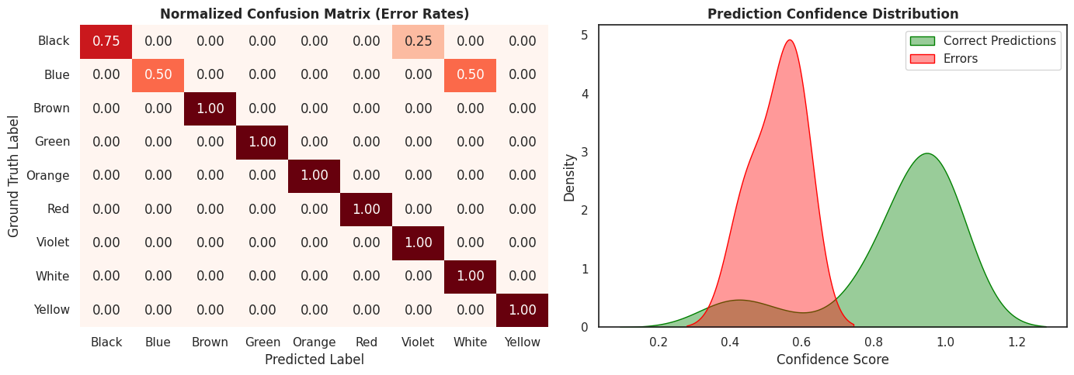
Danielle Gauthier
Modeling Strategy
Model
Role
Random Forest (normalized RGB predictors)
Tree model with many predictors
4
Summer 2026 MSDS 422

Slide 8
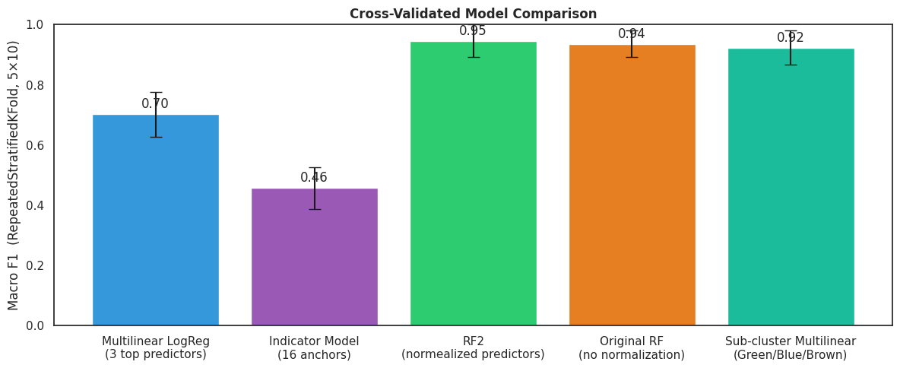
Daneille Gauthier
Results
Cross Validation Evaluation
Model 2
Multilinear LogReg (3 top predictors)
F1 = 0.702 ± 0.075
Model 3
Indicator Model (16 anchors)
F1 = 0.457 ± 0.070
Model 4
RF (normalized predictors)
F1 = 0.947 ± 0.053
Summer 2026 MSDS 422

Slide 9
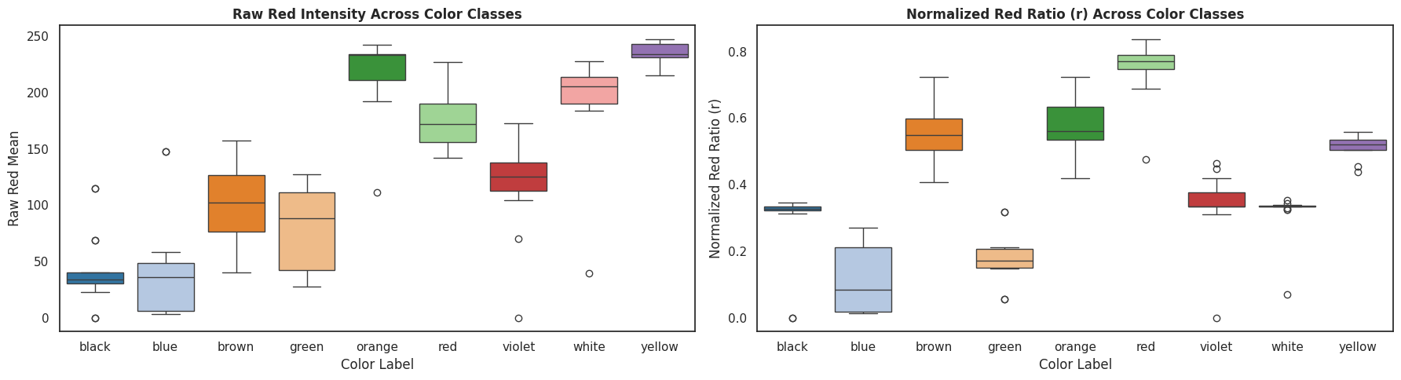
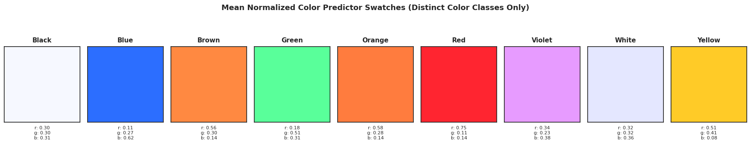
Danielle Gauthier
The solution
Summer 2026 MSDS 422
The best predictor color range uses 9 normalized colors.
Chromaticity normalization (r+g+b=1) gives clean, lighting-invariant separation for hued classes.
Main confusions are: Orange/Brown (near-identical chromaticity) and the neutral Black/White/Violet cluster (separable only by lightness).

Slide 10
Danielle Gauthier
Practicality
Summer 2026 MSDS 422
Best use: pre-sorting or tagging images by dominant color where approximate labels are acceptable; not for fine shade distinctions (nude vs. brown, pink vs. red).
Model power: the clean 9-class pipeline is lightweight (color statistics + logistic/forest), no GPU, and generalizes to new images.
Limits: small sample (261 train / 66 test), thin per-class support, and results depend on the mask threshold — so numbers are indicative, not production-grade. Cross-validation (not a single split) is what makes them defensible.

Slide 11
Danielle Gauthier
Next steps
7/27/26
Module 5 Midterm
8/31/26
Module 10 Final
12/20/26
NLP/DL Courses Complete
Summer 2026 MSDS 422
We’re here!
9-class pipeline, collinearity-corrected and cross-validated.
add a lightness channel to separate neutrals; try UMAP for nonlinear separation; tune the mask threshold as a robustness study.
extend to CNN-based color/texture features for harder, multi-object images.

Slide 12
Danielle Gauthier
Value Adds
Source
Value
Calvo Ivanovic, Ingrid. 2024. "Colour Meaning Matrix: A Tool for Connecting Concepts to Hue, Value and Saturation." Pp. 214–[end page] in Color and Colorimetry. Multidisciplinary Contributions. Vol. XIX A, edited by Filippo Cherubini and Andrea Siniscalco. Milan: Gruppo del Colore–Associazione Italiana Colore.
maps concepts to color using hue plus lightness and saturation
Color Meaning Matrix
Surov, Ilya A. 2022. "Quantum Core Affect: Color-Emotion Structure of Semantic Atom." Frontiers in Psychology 13:838029. doi:10.3389/fpsyg.2022.838029.
color as a sphere (hue angle, chroma, lightness as spherical coordinates) gives a continuous state space where a color holds a probabilistic position
Color Sphere
Vattuone, Nicolás, Thomas Wachtler, and Inés Samengo. 2021. "Perceptual Spaces and Their Symmetries: The Geometry of Color Space." Mathematical Neuroscience and Applications 1(1):1–34. doi:10.46298/mna.7108.
chromatic induction and color-matching effects to one simple distance law
Geome-try of Color- space
Summer 2026 MSDS 422

Slide 13
Danielle Gauthier
Any questions?
Ask away!
Summer 2026 MSDS 422
Let's discuss any doubts or concerns.
Contact me at daniellegauthier2028@u.northwestern.edu

Slide 14
Thank you

